Slide 1
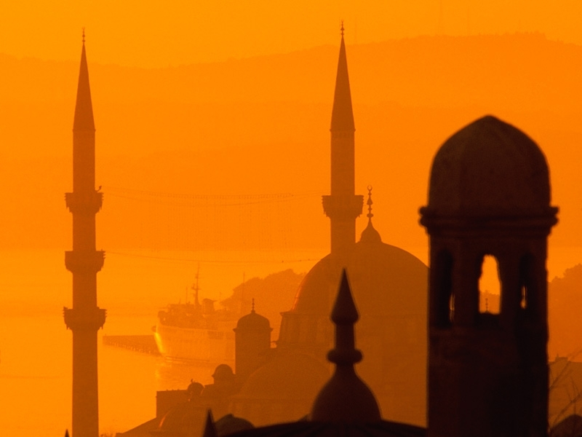
Islam

Slide 2
History.
The Quran.
The Five Pillars.
Traditions & Law.

Slide 3
Pre Islamic History
Decedents of Ishmael.
Many pagan religions1
Warraqa Ibn nofal.
Ebionisim
Cerinthianism
Notes:
The Kaba was a sactuary for of 360 dieties
Three dieties of particular interest were the ‘daughters of Allah’ – Al Uzza (Venus) to whom human sacrifices were offered.
El- Latt, and Manat.
Many of the ritulas of Islam were taken from these pagan practices, such as circling the Kaba 7 times
Muhammad had briefely worshipeed the daughters of Alla, but later he claimed that he had been decieved by satan.
In the pre islamic times the Kaba itself was decorated with pictures, some were bibilical, eg. Abraham, angesl, Jesus Mary.
Warraqa Ibn Nofal, was the priest of Mecca and Mohammad’s relative (4 the Grandfather.)
Warraqa was a Jew then beame an Ebonite (christian heritcal group). And he was a mentor to Muhammad
Ebonites do not believe in the divinity of Christ but thought he was a great prophet., and observed all the jewish rites, such as circumsicision ablution,. Etc.
Cerinthianims (Founded by Cerinth 100 AD) – Also believed that the Jesus was not God and believed in an Earthly Kingdom, that
Christ was to establish an earthly kingdom , i.e. at his seconed coming he will establish a 1000 year reign of earthly pleasure, also followed the jewish practices.
Elxasim- Elxai a gnostic sect

Slide 4
History
Muhammad 570 AD- 632 AD
Married Khadija at 25 y.o.
Muhammad had 12 wives and many concubines.
Muhammad has visions.
People of Mecca turn on Muhammad.
622 A.D. Muhammad goes to Medina (El Hijra)
Notes:
Born in Mecca
He was born to Arab Pagans, poor.
His father died before he was born and his mother a few months after he was born.
His grandfather took care of him.
His Uncle then looked after him, who was trader (merchant) and so he used to travel with him and may have learnt about jews and christianity on these trips.
While a young man he worked for a very rich widow calld khadija whom he married when he was 25 y.o. She was 15 y.o.
He had serveral children with her but only one survied to adulthood that was Fatima.
12 wives the last was Mary (a coptic girl), the youngest was 6 y.o (aisha) – muslims are only allowed 4 wives.
After marrying khadija he didn’t have to work to he used to go to a cave near his house and spend much time in meditation. He sees a spiritual being. He thought was a devil, but his wife said it was an angel (later he said it was Archangel Gabriel.)
This being said he had a message driectly from God to preach to humans.
Over the years these visions become frequent and Muhamed began telling people about his experiences to a small group of people who began to believe him and follow him.
His visions were a mixture of Jewish, Christian and pagan beliefs.
One of the manin themes was that there is “one god”.
The people of mecca were pagans and did not like his message so they turned on him and his followers and so in in 622Ad he fled to Medina
The Hijra is very important to the muslims as the Muslim calander starts from this year. (much persecutions and death of the muslims by the pagins of Meca)
And also give rise to the Hijra doctirne (when in danger migrage to a safe place, and later when you are stronger attack the enemy and retake any lost land.)

Slide 5
History
In Medina Muhammad becomes powerful.
Prophet of the Jews and Christians.
630 A.D. Muhammad invades Mecca.
632 A.D. Muhammed dies aged 62.
Succed by Abu Bakr.
Muhammad the perfect man.
Notes:
The people of Medina accepted Muhammad’s teachings and he became very powerful and influential. He united the warring tribes of Medina because of this they made him their leader. He went from being a preacher to a powerful leader of the first Mulsim state (city)
He was their ruler, law maker, judge and military commander.
Muhammad believed the was sent by God as a final prophet to the jews and Christians and so he taught that prayer was towards Jerusalem. And he tried peacfully to convert the christians and jews of Medina
However the jews and Christians refused his teachings so he became angry with them and changed the direction of prayer from Jerusalem to Mecca. And at the same time his visions stpped begin peacful towrads the Jews and Christians and became harsh and violent.
He massacred hundres of Jewish men and enslaved their families.
The numbers become more powerful in Medina and he invades Mecca in 320 A.D.
Abu Bakr was one of his closest folowers, who folowed Muhammads example of vciolence and used holy war or jihad to force people to accept islam as their relgion ot to submit as seconed class citizens.
Muslims believe that Muhammad was the perfect many and so everything he did and tuaght was perfect and his life must be used as an example of how to live. That is why many muslims still believe that Islam must be spread by violence and throug jihad.

Slide 6
Summary
570: Mohammed is born in Mecca
573: Abu Bekr, Mohammed's father in law and first Caliph of the Mohammedans is born
606: Fatima, Mohammed's daughter is born
610: Mohammed has a vision on Mount Hira
615: Mohammed starts teaching his religion.
622: Mohammed is forced to flee Mecca for Medina. This event is called the Hegira and is year one on the calendar for Islam.
624: Mohammed marries Aisha who is the ten-year-old daughter of Abu Bekr.
625: Mohammed begins to dictate the Koran.
627: Mohammed's enemies from Mecca besiege Medina and slaughter 700 Jews.
628: Mohammed captures Mecca and writes letters to all the rulers of the world explaining the principles of the Moslem faith.
632: Mohammed dies he is replaced by Abu Bekr who makes his capital Medina. Fatima also dies.

Slide 7
Spread of Islam
Golden Age:
632-634 Abu Bakr (1st Islamic Caliph)
634-644 Omar (assissinated)
644 – 656 Othman (assissinated)
656-661 Ali and his descendents – Shia (assissinated)
Notes:
Difference between Shia and Sunni
Shia believe that the Caliphs or leaders must be descendents (family of Muhammad)
Where as Sunni believe the leader should be the most capable of the job (i.e. Chosen)
So shia redoginise the first Caliph (whom they call Imam) was Ali
Sunni are the mojority, Shia probably make up about 15% of muslims WW.
Despite all the disagreements, assassinations, civil war and violence Muslims look back at this time as the ‘golden age’ of islam. They all call this the age of the four ‘Rightly guided Caliphs’
They consider this the golden asge as islam spread very quickly during this time to palestien, syria, iraq, persian, egyp and norht Africa. Which were all very strong Christian Communities.

Slide 8
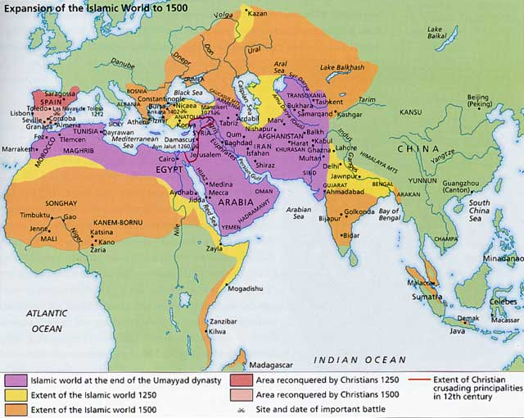
Notes:
By 750 Islam stretched from spain to india and china.
By the 12 Centry Islam spread throughout sout-east asia, malaysia, indonesia and Thaliand.
Mulsim used trade as a way of winning converts to islam and many muslims were keen slave traders. And so they moved to africa to capture slaves that’s why man of the African coastal regions and old slave routes are still muslim today.
By the 16the Century Islam into Turkey and the southern parts of Europe all the way to Austria (1529- 1683)
Touch on the crusades.
Constatinople falles to the ottomons in 1453
By the end of WW1 most muslim countries were under european colonial controls- which the muslims until today resent. By 1960 all muslim countires had regaind itheir independence.

Slide 9
Facts
2012 WWP 1.8 Billion. @ 24.1%
Christians WWP 2.2 Billion. @ 31%
Australia 25M, 2.61% Muslim = 650,000
Indonesia 262M, 87.2% Muslim = 229M
USA 328M, 1.1% Muslims = 3.2M
Less than 15% of Muslims are Arabs.
Notes:
Now days Islam expands through Higher birth rate, trade, business, politics, mass migration, marriage, conversion and some cases of violence and terrorism. They often use economic aid ot win converts in poor countries.

Slide 10
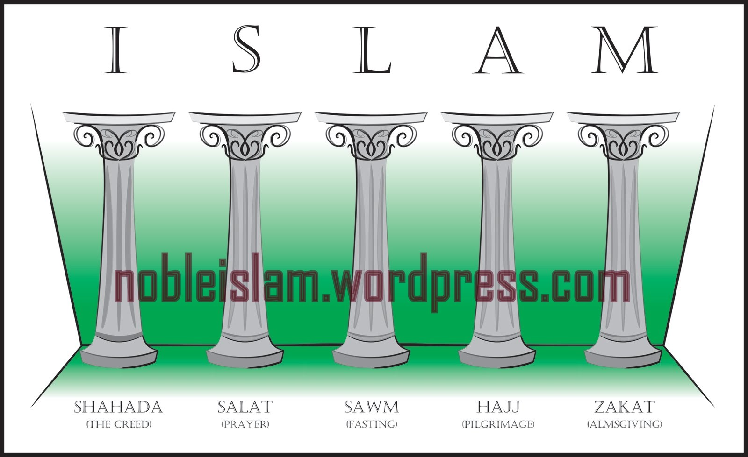
The Five Pillars
Notes:
The Pillars of islam are essential duties of muslims, i.e they must do it.
Shahda – Declaring the faith.
“I testify that there is no god but God and that Muhammad is the apostle of God.”
In order to become a muslim the person must recite this 3 times in front of two witnesses.
2. Salat – Prayer
In Islam, God is distant and impersonal. When muslims prya it is a ritual and they are not sure if God will even listne to their prayers.
Muslims have to perform all kinds of rituals before and during their prayers. Muslims belive that they have to be physically clean before they can pray. They have to was certain parts of their body, like their hands, head, face, teeth, mouth, beard, feet and toes. They must even rinse their nostrils out because they believe that when they sleep the devil stays in their nose. If they do not do these ablutions properly they believe that their prayers will not be counted as a good deed.
Pray 5 times a day.
Dawn, Midday, mid afternood, sunset and nightfall.
Friday is their holy day.
Muslims believe that whereever the call for prayer is heard, then this area is claimed for islam.
The call is
“God is great. I testify that there is no god but God and that Muhammad is the apostle of God. Come to prayer; come to success.”
3. Fasting
Month of Ramadan (9th month of islamic calander) Ramadan starts at the first sighting of the new moon and ends at the first sightin of the new moon of the next month.
Muslims fast during Ramadan to remember when Muhammad was supposed to have had his first vision of the angel gabriel.
Fasting means no food, drink smoking or sex from sunrise to sunset.
Strangely during this fasting period they eat more…
4. Hajj – Pilgrimage to mecca
Must do at least once in their life
This happens during the 12 month.
Go to the kabba walk around it 7 times counter clockwise
"Here I am at Thy service O Lord, here I am. Here I am at Thy service and Thou hast no partners. Thine alone is All Praise and All Bounty, and Thine alone is The Sovereignty. Thou hast no partners."
The Kaba was a pagan site before mohammads time and contianed many hunderds of pagan gods.
The idea of the Hajj came from mohammad when he returned to mecca from medina.
According to the muslims the Kabba
The muslims have a story that the Kabba is where Abraham left hagar and Ishmael. Hagar looking for food left Ishamael where the Kabar is and ran between the surrounding mountains of Safa and marwa seven times.
Stoning of devile, throw 7 stones at pillar
Scarificing of animal (i.e. the sacrifice of Abraham.)
Many of these ritulas have come from the pagans in mecca and how they used use the Kaba
5. Zakat – Giving
Muslims believe that if they give money to support islam and help poor muslims, then they have a better chane of going to paradise. They give 2.5% of all they earn.

Slide 11
Jihad (Holy War)
Dar al Islam
Dar al Harb
Notes:
House of Islam an place where muslims rule
House of War any place where muslims do not rule.
According ot raditional islam. Jihad is God’s way to expand Islam’s rule
Some (very few) muslims reject this view and explain jihad as a spirutal fight against sin.
Most muslims today agree that Jihad is a religious duty to defend islam and go as far as calling it a 6th pillar.

Slide 12
Six articles of faith
God (Allah).
Angels.
Books.
Prophets.
The day of judgment.
Allah’s sovereign decrees (predestination).
Notes:
Six articles of faith that the muslims must believe.
God is one and has no partners.
Angels. Angel Ghabrial is the gretest and also is called “the spirit of God’ (ie they claim the holy spirit) Also believe in jin (eviel spirits)
Books Believe in 104 sacred books of these only 4 now remain. The Torah, the psalms, the Gospels and the Quran. However they believe that the jews and christians alterd their books so God gave the Quran to Mohammad as the final revelation to mankind.
Prophets
The day of judgment and end days. They believe in an antichrist and a messiah. Also Jesus will come back in the last days as a muslim. Then all will be ressurrected and wounder around for 40 years after which time all will be judged. By walking over a thin bridge…
The beleiver msut submit to Allah’s will

Slide 13
The Quran
Written by Muhammad?
First compiled by Abu Bakr.
Quran must only be in Arabic.
114 Chapters (sura)
Abrogation.
Notes:
They claim that muhammad is the mesenger of God and the quran was the message given to muhammad from God via Angel Ghabrial
Their first time angel appeared to muhammad he was 40 y.o.
His different followers would memorise each message or wite it donw on different things.
No one collect all his message into a signle book unti long after his death.
The Hadith tells us how the stories in the Koran came to be in one book. After Muhammad's death his converts noticed many wide ranging differences and discrepancies in what the Muhammad revealed. So a man named "Abu Bakr" began to gather all known "Kuranic" materials. He then, like a newspaper editor, he sat down what would go in the Koran and what was to be thrown out. He even had to translate certain parts of the Koran back into the Quarish dialect. Once he decided upon a final version of the Koran, he had to issue an order (likely at the threat of death) to destroy all known fragments of the Koran. Since Islam was contained in a relatively small geographic area at this point, the order to destroy variant texts was easier. At the same time, Abu Bakr sent out his final edited version of the Koran, which was ordered to be the sole OFFICIAL version. That is the version that we see today.
Other scholars believe it was Uthman who collated the different fragments of the quran and ordered the destruction of all other fragments…
Muslims believe that the quran is an exact copy, word for word, of a quran whichhas existed for ever.
They are arranged by length not chronological order.
The quran was supposeldy given to provide guidance for Muhammed and his followers for situatiosn they were facing…
Abrogation. – problem even the islamic scholars can not be sure what comes frist…
The quarant teaches that the Bibile is the genuine word of God, however muslims say that the bible we have has been altered.
Jesus is a prophet, was born of a virgin, performed miracles and was sinless. he did not dies on the cross and is not the son of God.

Slide 14
Muslim Traditions & Law
Sunna.
Hadith.
Sharia. – Maliki, Hanafi, Shafii, Hanbali
Taqiyya
Notes:
Sunna: Muslims believe that everything Muhammad did and said was directed by God. Muslims believe that they have to follow Muhammads example and way fo life, his actiosn and his words are called his sunna.
Hadith:
For 150 years after muhammads death, his life and stories were handed down by mouth. After that muslim scholars started to gather toghether some of these stories and wirte them down. Each scholar made his own collection of stories. These collectiosn are called the hadith.
The hadith is very important to muslims as a source of guidance from God. They are thon only thing considered more important is the quran. They use the hadith to explain the quran and to make laws.
Most of Islamic law and culture is based on the hadiths not the quran.
Sharia is the legal system, what is allowed (hala) and what is forbidden (haram)
There are 4 different version of Sharia
Sharia dictates every part of life.
Taqiyya – to lie or decieve 3 reasons are allowed for lieing
A man may lie to his wife to please her
To bring peace between tow groups that have been quarrelling
War.

Slide 15
Women in Islam
2nd Class.
Sharia law a women is ½ the value of a man.
Muta
Notes:
In Islam the reason women are treated as lower then men is because they are seen as lacking intelligence, morals and religion. They are also seen as a source of sexual temptation to men. Muhammad said that most of the people in hell are women.
i.e. two women witness are equal to one male witness.
A women only inherits half of what her brother does.
If compensation is givne a women gets only half what a man gets for the same injury.
The only way a women can get to heaven is to obey her husband.
A muslim can divorce simply by saying ‘I divorce you’ 3 times in front of a witness.
A muslim man is able to have a temporary marriage called a muta – this has caused the spread of aids in many african countires.
Muta – temporary marriage

Slide 16
How should we deal with Muslims
Love.

