Slide 1
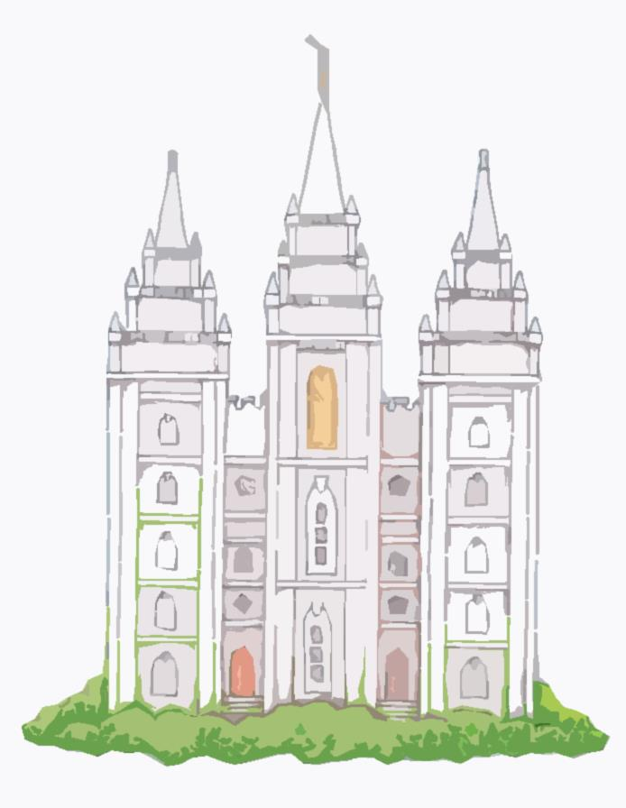
Mormonism
The Mormon Church or as it is officially known as the Church of Latter-Day Saints (LDS)

Slide 2
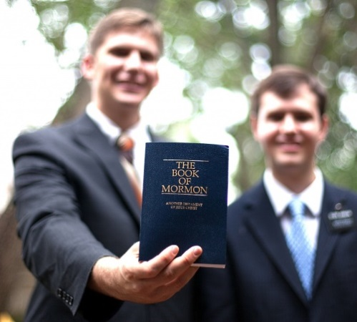
Introduction
The Mormon Church is a very successful cult in the United States. Mormons promote a highly attractive and admirable face that communicates strong family values, clean living and a commitment to Christ.
To understand Mormonism,
one needs to look at their sacred texts and consider where they came from. The church claims to believe in the Bible, "insofar as it is correctly translated" (The 8th Article of Faith), which basically means whenever it does not conflict with good Mormon theology.

Slide 3
The story of Mormonism centres on Joseph Smith Jr. and his many revelations. When he was only 14, he had a vision where he was visited by 2 “persons”-whom he believed were the Father and the Son. When asked which denomination he should join, they responded with none, they are all “wrong and corrupt.” Three years later, he had another vision, this time of the angel Moroni who told him of a book written on golden plates by former inhabitants of the continent that contained the “fullness of the everlasting gospel.” At the age of 21, he found these plates and began translating them using “seer” stones an occult prediction technique he had refined with his dad when hunting for treasure. (Occult is the study of hidden wisdom. It can involve such subjects as magic, astrology, extra-sensory, perception and numerology).
By 1830, Smith had published the Book of Mormon (BOM). For the next 10 years, he continued to receive revelation which would become his additional inspired scripture Doctrines and Covenants (D&C), and The Pearl of Great Price (PGP)

Slide 4
The Book of Mormon
This book covers the history of 2 (unknown) civilizations which supposedly made their way from the Middle East to America around 600 B.C. These 2 nations, the Nephites and Lamanites, were of Jewish origin and for centuries were enemies. Mormon, the commander of the Nephites recorded on the gold plates what was to be the BOM. Mormon gave these plates to his son, Moroni, who hid them until they were uncovered by Joseph Smith Jr.
The Mormon church has gone to great lengths to justify the BOM – even coming up with its own archaeological support of its authenticity. The non-Mormon archaeologists, however, has never given it any credibility. Interestingly, the manuscripts for the BOM have disappeared as Moroni came back and took the gold plates. Mormons must accept only Joseph Smith Jr.’s word. The theory that the Book of Mormon is an ancient American history is considered to fall outside academic credibility.

Slide 5
Doctrines and Covenants
Although the BOM was termed the “most correct of any book on the earth,” the D&C has 13 key doctrines not found anywhere in the BOM. Among these new revelations were: plurality of gods, God as an exalted (distinguished) man, a human being’s ability to become God, three degrees of heaven, polygamy, eternal progression and baptism for the dead. In addition, it is laden with prophesies by Smith that never came true (which would make him a false prophet).
The Pearl of Great Price
This book was translated from papyri fragments found when Smith bought some Egyptian mummies. According to Smith, this is a record of writings by Abraham while he was in Egypt. Assumed lost, these papyri resurfaced in 1967 when they were studied by non-Mormon scholars. It was discovered that the characters were indeed Egyptian but translated into instructions for ancient Egyptian funerary practices including mummification of the body. Smith, however, understood it to teach the Mormon doctrines of pre-existence, the priesthood and the nature of God.

Slide 6
What Mormons Say About:
God
Mormonism teaches polytheism (versus monotheism taught in the Bible), believing that the universe is inhabited by many gods who produce spirit children. Joseph Smith declared, "I will preach on the plurality of Gods. I have always declared God to be a distinct personage”.
Man and the Universe
The Mormon Church teaches that man was a pre-existent spirit and that mankind is of the same species as God. Our origin is supposed to have been as procreated children of God, born as spirits in some other realm. In that spirit world existence we progressed as far as was possible, but to become truly like our Heavenly Father we needed to obtain physical bodies.
The Black person is an unfortunate man. He has been given a black skin. He is not permitted to receive the priesthood and the ordinances of the temple, necessary to prepare men and women to enter into and enjoy a fullness of glory in the Celestial Kingdom" (Elder George E. Richards).
In 1978, however, the Mormon Church announced that God had lifted his curse from the African race. (God has changed his mind????)

Slide 7
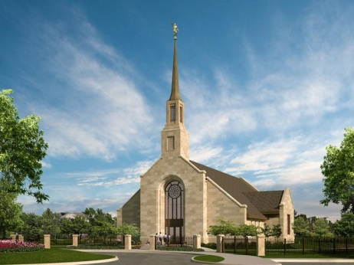
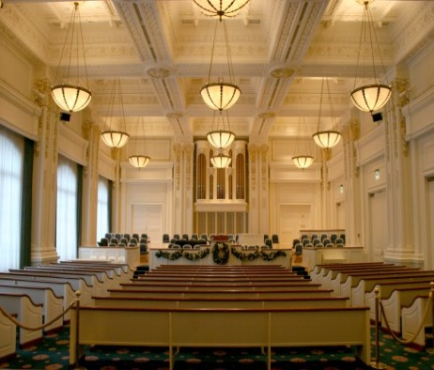
The Mormons Worship
There are 2 kinds of worship in the Church of Latter Day Saints: chapel worship and temple worship.
Chapel worship is the primary family worship service called sacrament meeting. This meeting is held in chapels on Sunday and lasts approximately 70 minutes, involving the whole community together. During the service the members receive a sacramental communion of bread and water, during which they remember the Last Supper, the suffering of Jesus Christ, and their own baptismal promises to serve the Lord and keep his commandments.
Temple worship is something altogether different. First of all, it takes place in the
temple. Mormon temples are used for baptisms for the dead, and what is known
as "endowment ceremonies" for both the living and the dead.
A former Mormon explained an endowment ceremony: "The ritual began in a small cubicle where we had to strip completely. We then put on 'the shield,' a poncho with a hole for the head, but open on the sides (similar to a hospital gown). We went through a series of ‘washings and anointing’, as various parts of our bodies were touched by elderly temple workers who mumbled appropriate incantations over them. The endowment ceremony mocked all doctrines held to by Biblical Christianity, and Christian pastors were portrayed as servants of Satan. We had to swear many blood oaths, promising we would forfeit our lives if we weren't faithful, or if we revealed any of the secrets revealed to us in the temple ceremonies.

Slide 8
How the Mormons differ in their believes from Christianity:
Elements of Faith | The Church of Jesus Christ of Latter-day Saints (Mormons) | Traditional Christianity
Supreme Being | In Mormon thinking, God of earth is not the cause of everything. He was created by other another god who had been created by another without end or limit. The Mormon Father God actually grew up as a man on another planet, learning all he could and finally dying and then being resurrected into Godhood whereupon he returned to a heavenly place with a body of flesh and bones. Mormon doctrine of continuous revelation, states that God would actually change what He has previously revealed | One personal/supreme God who is Creator & Lord of everything that exists. He eternally exists as Triune God: Father, Son, Holy Spirit. Gen. 1; Deut. 6:4; Matt. 28:19. The Bible makes it explicitly clear that God does not change; that he is the same yesterday, today and forever.
Key Figures in History | Joseph Smith Jr. (1805-1844) | Jesus, the Christ, eternally one with the Father and incarnated supernaturally through the Virgin Mary. John 1:1-12; Matt 1:18-25
Person of Jesus | Jesus is the spiritual & physical offspring of God by procreation. Had a pre-existence as God's firstborn spirit child and followed by his brother Lucifer. God needed a saviour to implement his plan. Jesus won the contest, Lucifer lost. Lucifer was so enraged with jealousy that there was war in heaven and Lucifer and his angels were cast out. | Lord Jesus Christ is perfect in His divinity and perfect in His Humanity, yet His divinity parted not from His humanity for a single moment nor a twinkle of an eye Supreme example of God's character & His love for humanity. Full and final revelation of God and His love. John 1:1-13

Slide 9
Sources of Authority | Bible (except the "errors"); The Book of Mormon; Doctrine and Covenants; Pearl of Great Price; revelations of the Mormon prophets | Bible (Old & New Testaments). Unique, revealed, factual, accurate, & inspired Word of God. 2 Tim. 3:16-17.
Doctrine of Humanity | Pre-existent spiritual offspring of God; basically good; gods in embryo. | Humanity is part of creation, but distinct from the rest of creation & from God. Human beings are created in God's image. Every person is a unique, precious being of dignity & worth. Gen. 1:26-28.
Ethics (Value System) | People are to obey the laws of God; Mormons expected to observe the "Word of Wisdom" (rules for conduct). | Ultimate values for humanity are based on God's character and His Ten Commandments. Jesus teaching in the new Testament. The sermon on the mountain (Mathew 5) was to fulfil the commandments. He set up the Ethics for Christianity and the world civilisation.
Life After Death | One of three kingdoms: 1. Celestial-renewed earth, where men become gods or angels; 2. Terrestrial-planet for righteous non-Mormons; 3. Telestial-planet for the wicked. Perdition is reserved for Satan and most wicked. | Eternal communion with God (heaven) or eternal separation from God (hell). Heb. 9:27; Rev. 20-22

Slide 10
The key point of debate with the Mormon faith:
We need to look at the origin and authenticity of their sacred text, the Book of Mormon.
Criticism of the Book of Mormon
The accuracy of Smith's story has been questioned, however. Most scholars reject Smith's claims of ancient origin and many believe that it was fabricated by Smith, drawing on material and ideas from contemporary 19th-century works rather than translating an ancient record, noting that no evidence of a supposed Reformed Egyptian language has ever been discovered. The content found within the book has also been questioned. Scholars have pointed out a number of anachronisms (belonging to a period other than that being portrayed.) within the text, and no archaeological or genetic evidence has supported the book's claims about the indigenous peoples of the Americas. The text has also undergone many significant revisions, which critics see as a rebuttal of its supposedly divine origins.
Adherents have defended the book against these scholarly claims. The oldest, and most significant, defence of the Smith's story comes from the testimonies of the Three Witnesses and the Eight Witnesses, which are published in every copy of the book. For instance, an identification of Reformed Egyptian with a known ancient Egyptian dialect has been proposed, but, as previously mentioned, there is no evidence for this.
Scholars reject Smith's explanation of the origin of the Book of Mormon. Joseph Smith said that the Book of Mormon was originally an ancient native-American record written on golden plates, and that God gave him the power to translate it into English. Critics note that there is no physical proof of the existence of golden plates; Smith said that the angel Moroni reclaimed the plates once he had completed the translation.

Slide 11
Scholars and expert analysis of the BOM shows:
No evidence of the Existence of golden plates
One of the Mormons key witnesses of the BOM, Martin Harris stated (after he departed from the group) that the Eight Witnesses never saw the plates, and that his own witness was more spiritual than physical. Additionally, each of the Three Witnesses (Martin Harris, Oliver Cowdery, and David Whitmer) left the church during Joseph Smith's lifetime and considered Smith to have been a fallen prophet.
Text & Language used does not match ancient writings
The Book of Mormon claims to be the original writings of Nephite leaders in ancient America, but it contains extensive quotation of the 17th century edition of the King James Bible (KJV) and the deuterocanonical books, which Joseph Smith's bible had as well. Furthermore, the language of the Book of Mormon mimics the Elizabethan English used in the KJV with 19th century English mixed into it.
The Book of Mormon quotes 25,000 words from the KJV Old Testament and over 2,000 words from the KJV New Testament.

Slide 12
Conclusion
If it weren’t that people’s salvations were at stake, Mormonism would make for great science fiction. Mormons are so far from traditional Christianity that it is a wonder how anyone could consider this theology as true. Real Truth is eternal, it does not change.
The Mormon faith is polytheistic. Ask a Mormon to his/her face and they will probably tell you that they believe in "God the Father and His Son Jesus Christ and the Holy Ghost." Sounds pretty orthodox,
until you define those terms. In reality, Mormons believe that
the three parts of the trinity are separate gods, and that
there are in fact numerous gods, and that any man can
himself become one. God the Father is only the god of
Earth, just as every other planet in the universe has their own god.
In point of fact, Jesus is not the one Mormons are following
. . .Joseph Smith Jr. is!

Slide 13
The End

